Slide 1

Customer Target Analytics Dashboard

Slide 2
Task 1: Data Modeling & Cleaning
The dataset has been extracted and loaded in power bi.
Then, it is transformed and loaded in Power Query Editor where the duplicates and the incorrect datatypes have been corrected.
Then, a Membership_Duration column have been created in the Power Query Editor using the formula: Membership_Duration = Today – Membership_Since. Later the Transaction_Year and Transaction_Month have been extracted.
After this, in the data model view, one to many relationship have been created Customer_Demographics → Transactions, Loyalty_Program, using drag and drop to the common columns. Then, a many to one relationship have also been created between Transactions → Store_Locations using the same approach.

Slide 3
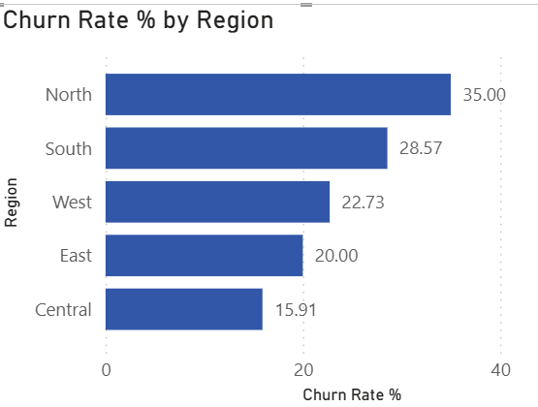
Task 2: Churn & Retention Metrics
A measure has been created in the data view called Churn Rate% under the Churn_Labelled_Customers using the formula: Churn Rate KPI = (Churned Customers / Total Customers) * 100
Visualization of Churn Rate by Region:

Slide 4
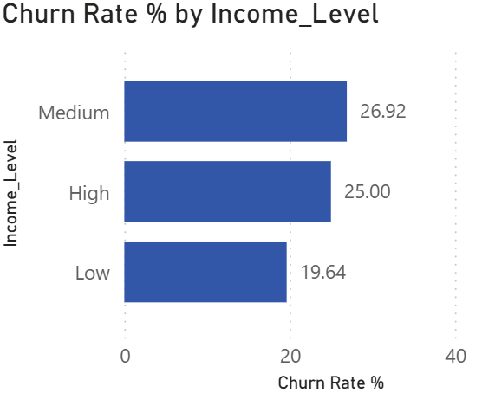
Visualization of Churn Rate by Income Group

Slide 5
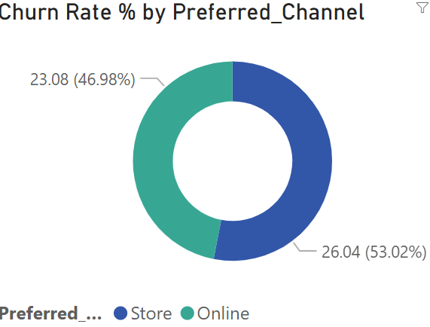
Visualization of Churn Rate by Channel (Store/Online)

Slide 6
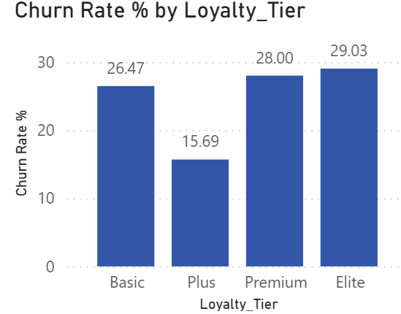
Visualization of Churn Rate by Loyalty Tier

Slide 7
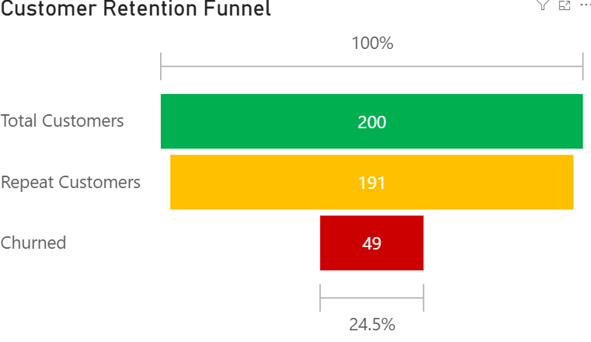
Funnel Chart: Total Customers → Repeat Customers → Churned

Slide 8
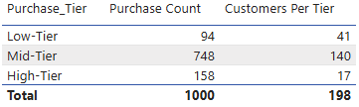
Task 3: Repeat Purchase Analysis
Customers have been segmented in the following pattern:
Low-Tier: 0–3 purchases
○ Mid-Tier: 4–8 purchases
○ High-Tier: 9+ purchases
A column named Tier_Order have been created under the Customer_Transactions table with the following formula:
Tier_Order = VAR CustomerPurchases = CALCULATE( COUNTROWS(Customer_Transactions), ALLEXCEPT(Customer_Transactions, Customer_Transactions[Customer_ID]) ) RETURN IF(CustomerPurchases <= 3, 1, IF(CustomerPurchases <= 8, 2, 3))
After implication of the above formula and sorting the Tier_Column, beside is how the arranged table looks like:

Slide 9
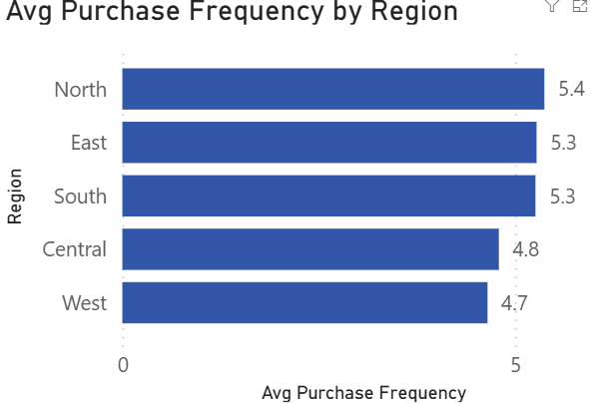
Compare avg. purchase frequency by Region, Age Group, Loyalty Tier
Avg Purchase Frequency measure has been created under Customer_Transactions table with the help of the following formula:
Avg Purchase Frequency = DIVIDE( COUNTROWS(Customer_Transactions), DISTINCTCOUNT(Customer_Transactions[Customer_ID]), 0 )
The visual of Avg Purchase Frequency by Region has been created using Clustered Bar Chart and keeping Avg Purchase Frequency in x-axis and Region in y-axis.

Slide 10
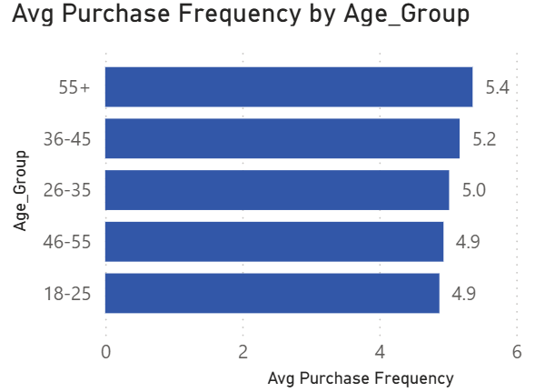
Average Purchase Frequency by Age Group
This visualization has been created using the clustered bar chart by keeping Avg Purchase Frequency in x-axis Age_Group in y-axis,

Slide 11
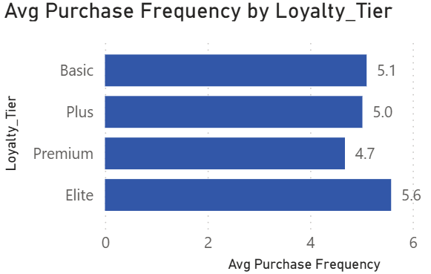
Average Purchase Frequency by Loyalty Tier
This visualization has been created with the help of clustered bar chart by keeping Avg Purchase Frequency in x-axis and Loyalty Tier in y-axis.

Slide 12
Most purchased product categories by loyal customers
To find this, a measure named Loyal Customer Purchases have been created under the Customer_Transactions table with the help of the formula below:
Loyal Customer Purchases = CALCULATE( COUNTROWS(Customer_Transactions), FILTER( Loyalty_Program, Loyalty_Program[Loyalty_Tier] = "Premium" || Loyalty_Program[Loyalty_Tier] = "Elite" ) ).
After this, a visualization has been created using clustered bar chart and keeping Loyal Customer Purchases in x-axis and Product_Category in y-axis.
A slicer has also been embedded for Loyalty_Tier from the visualization panel in order to apply filter among the several categories of Loyalty_Tier.
Below is the visualized graph along with the slicer beside it.

Slide 13
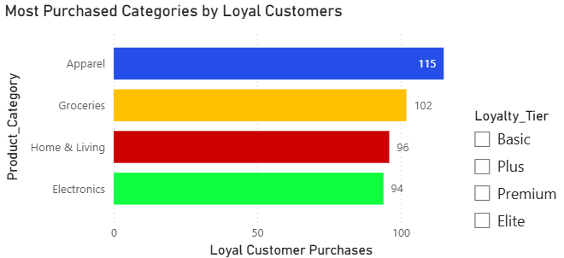

Slide 14
Task 4: Promotion & Loyalty Impact
A measure named Promotion Transaction% has been calculated under Customer_Transactions table using the formula below:
Promotion Transaction % = DIVIDE( COUNTROWS( FILTER( Customer_Transactions, Customer_Transactions[Promotion_Applied] = "Yes" ) ), COUNTROWS(Customer_Transactions), 0 ) * 100
A measure named Avg Amount with Promotion has been created under Customer_Transactions table using the formula below:
Avg Amount With Promotion = CALCULATE( AVERAGE(Customer_Transactions[Amount]), Customer_Transactions[Promotion_Applied] = "Yes" )
A second measure named Avg Amount without Promotion has been created under Customer_Transactions table using the formula below:
Avg Amount Without Promotion = CALCULATE( AVERAGE(Customer_Transactions[Amount]), Customer_Transactions[Promotion_Applied] = "No" )

Slide 15
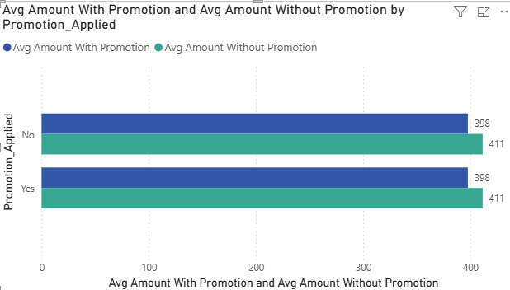

Slide 16
Visualization of Churn Rate% by Loyalty_Tier
This visual has been created using Clustered Bar Chart by keeping Churn Rate% in x-axis and Loyalty_Tier in y-axis.

Slide 17
Visualize Points Earned vs. Redeemed by Tier (Clustered Column Chart).
Two measures named Total Points Earned and Total Points Redeemed have been created under Loyalty_Program table using the following formulas:
Total Points Earned = SUM(Loyalty_Program[Points_Earned])
Total Points Redeemed = SUM(Loyalty_Program[Points_Redeemed])
A clustered column chart has been visualized by keeping Loyalty_Tier in x-axis and Total Points Earned, Total Points Redeemed in y-axis in the next slide.

Slide 18
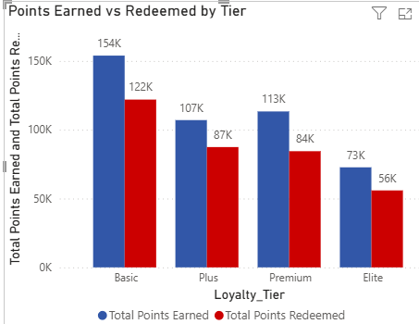

Slide 19
Recommendations to improve redemption & retention
1. Launch targeted campaigns for North region (35% churn)
2. Restructure Elite tier benefits to reduce 29% churn
3. Shift to bundle promotions to increase avg spend
4. Send redemption reminders to high points earners
5. Replicate Plus tier success across other tiers

Slide 20
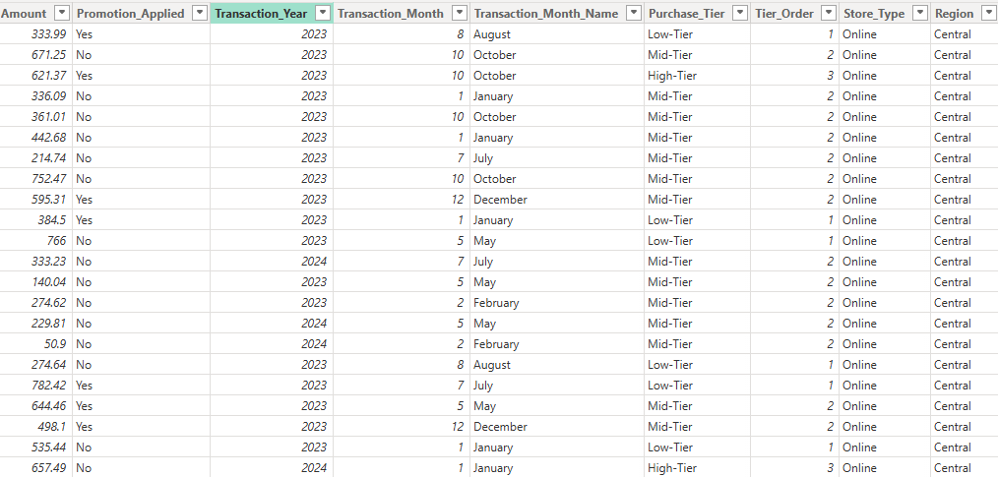
Task 5: Store & Channel Performance vs Retention Merge store data with transactions
In the power query editor, look for combine group and then click merge queries.
A Store_ID option has to be selected when the dialog box opens, then join kind and select left outer.
A new column named Store_Locations appears and then upon clicking the expand icon and selecting Store_Type and Region, two new column gets added to the table.

Slide 21
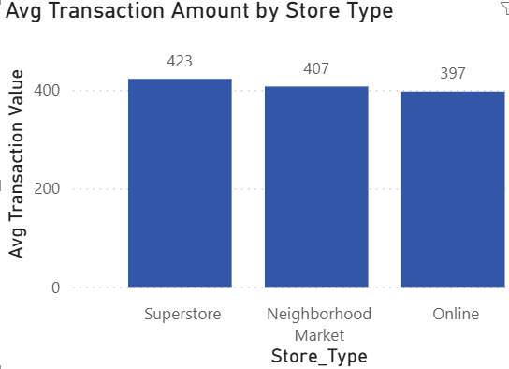
Visualization of Avg. Transaction amount by Store Type
This visualization has been created using the clustered bar chart by keeping Avg. Transaction Value in x-axis and Store_Type in y-axis.

Slide 22
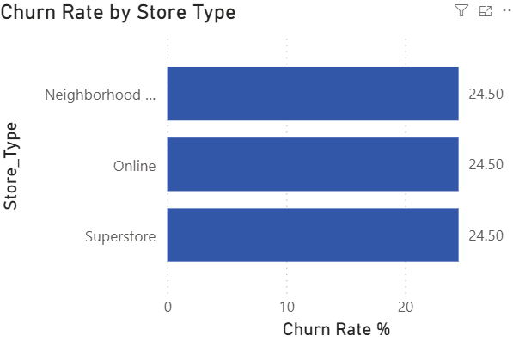
Visualization of Churn Rate by Store Type
This visualization has been created by using the clustered bar chart and keeping Churn Rate% in x-axis and Store_Type in y-axis.

Slide 23
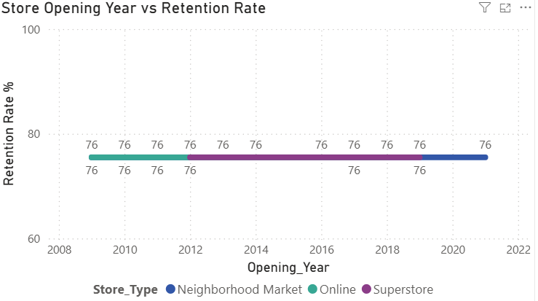
Visualization of Correlation between store opening year & retention
This visualization has been created using the line chart by keeping Opening_Year in x-axis, Retention Rate% in y-axis and Store_Type in legend.

Slide 24
Task 6: Customer Lifetime Value (CLV) Analysis
A CLV value has been calculated using the calculated column under the Customer_Demographics table with the help of following DAX formula:
CLV = DIVIDE( CALCULATE(SUM(Customer_Transactions[Amount])), DIVIDE(Customer_Demographics[Membership_Duration], 365), 0 ).
Segmentation of customers into Low CLV and High CLV has been done by creating a column named CLV Segmen t under the Customer_Demographics table by using the following DAX formula:
CLV Segment = IF( Customer_Demographics[CLV] >= CALCULATE( AVERAGE(Customer_Demographics[CLV]), ALL(Customer_Demographics) ), "High CLV", "Low CLV" )

Slide 25
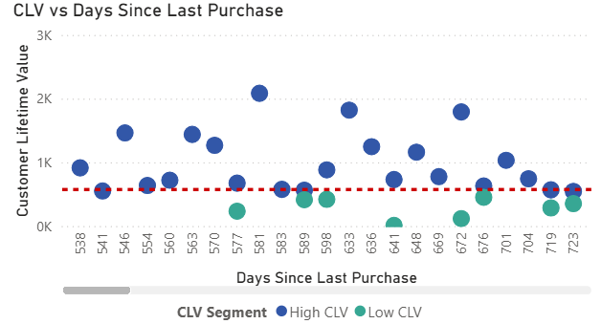
Visualization of CLV vs Days Since Last Purchase
The visualization of CLV vs Days Since Last Purchase has been done using Scatter Chart visual by keeping Days Since Last Purchase in x-axis and Customer Lifetime Value in y-axis.

Slide 26
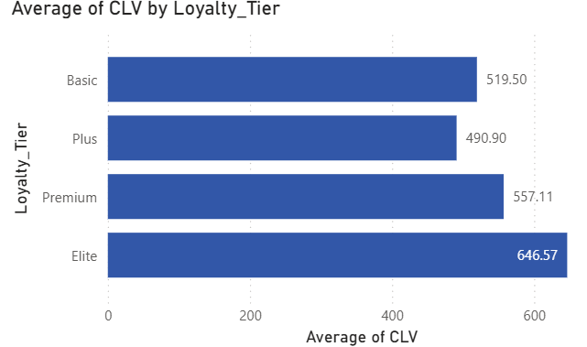
Visualization of CLV by Loyalty Tier And Region
The visualization of CLV by Loyalty Tier has been done by using clustered bar chart and keeping CLV in x-axis and Loyalty_Tier in y-axis.

Slide 27
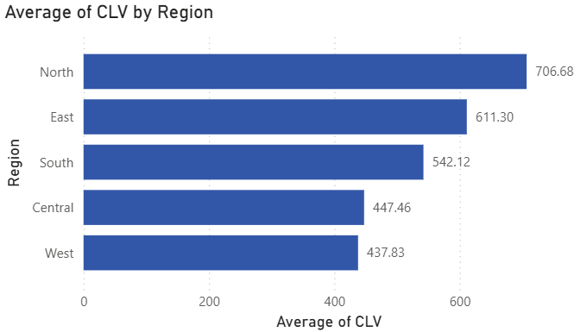
The visualization of CLV by region has been done with the help of clustered bar chart by keeping CLV in x-axis and Region in y-axis.

Slide 28
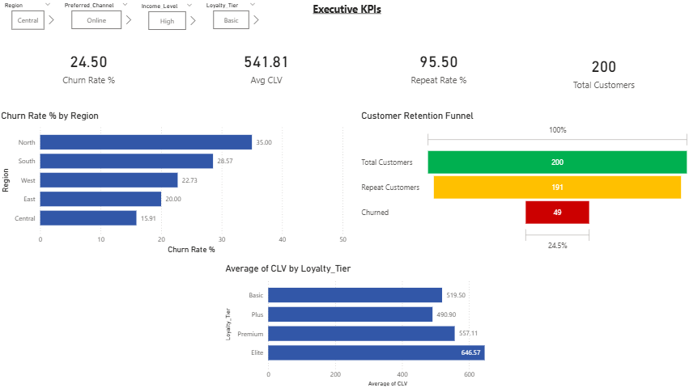
Task 7: Final Dashboard & Executive Summary

Slide 29
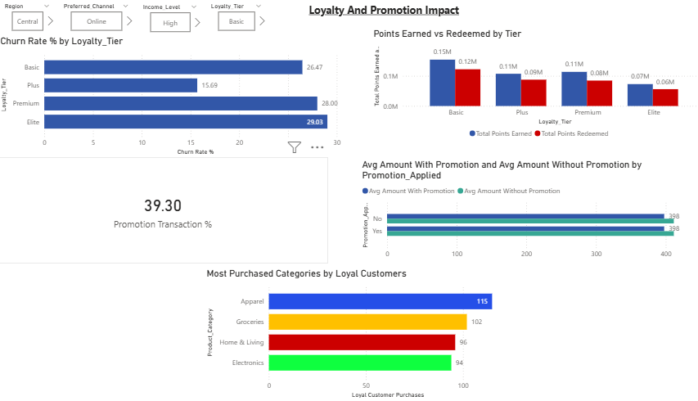

Slide 30
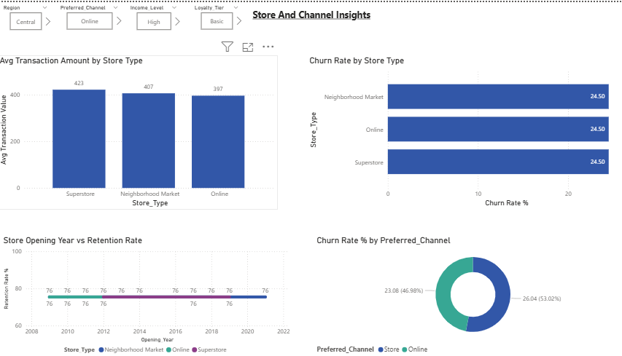

Slide 31
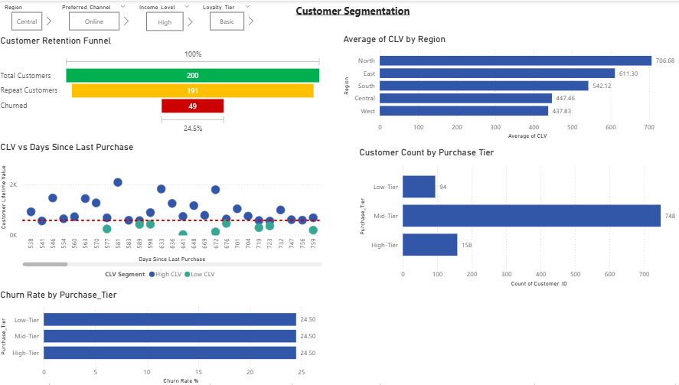

Slide 32
Top 3 Recommendations for Target:
Which customers to prioritize for retention?
Customers who are having high lifetime value but increasing inactivity are at highest risk Prioritize them with immediate re-engagement campaigns before they fully churn.
For elite and premium tier members, showcase them early sale access and free and fast delivery to strengthen and retain their loyalty and commitment.
And lastly, for the north region customers, provide them with exclusive offers and discounts to build a strong and long term relation.
Which Channels Are Underperforming?
Store Channel is underperforming as Store customers churn at 26% while Online customers at 23%
How to Strengthen Loyalty Engagement?
Send automated reminders when customers reach redemption thresholds.
Introduce points expiry to create urgency and drive active redemption.
Replace the promotional discount with bundle offers to increase the overall basket size.

Slide 33
Task 8: Video explanation: Expressing the finding and actionable insights.
Here’s the link for the video
https://www.loom.com/share/825e141be6074379bb220b91c4ac2410

